Slide 1
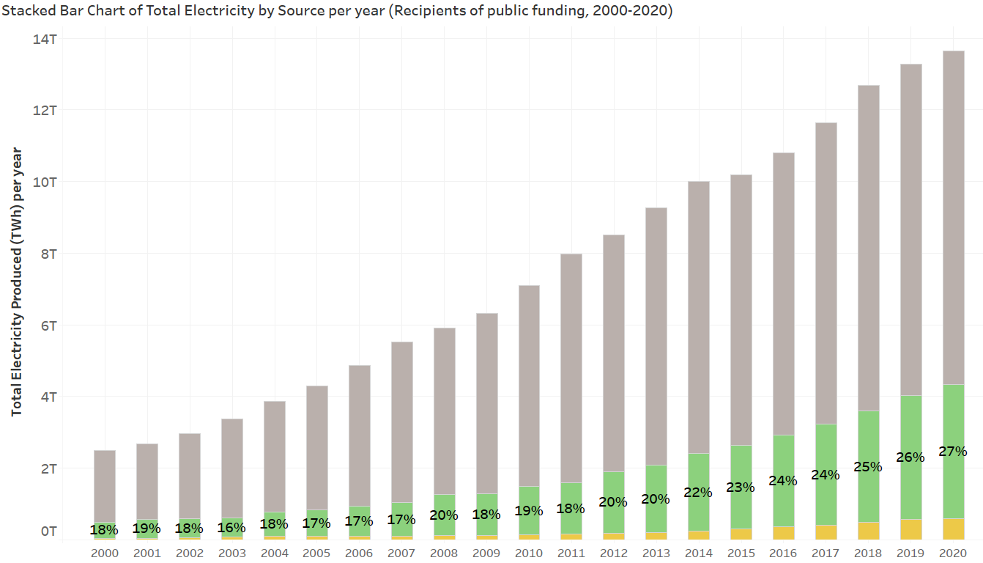
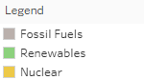
Share of Renewables has grown 9% in 20 years in LDC, but 12% globally
Notes:
Rrenewables have grown 9% in share through the past two decades in lesser developed countries but this is not self-sustained | and is linked to public

Slide 2
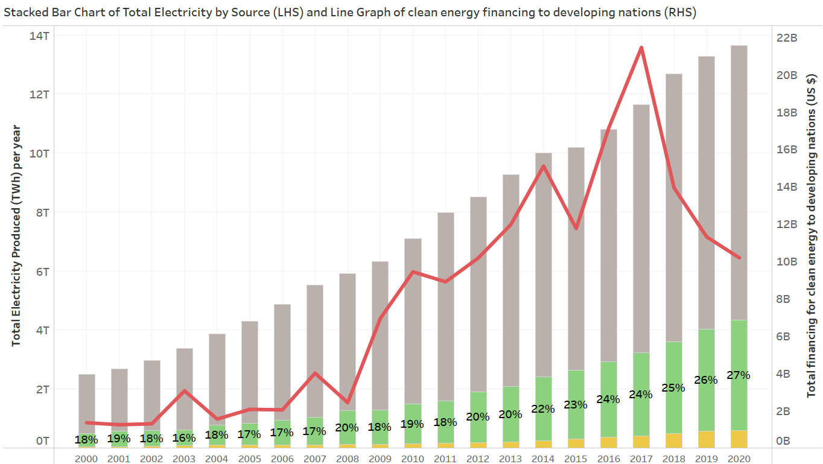
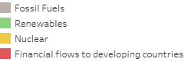
Growth is not self-sustainable, controlled by public financing with avg YoY growth of 21%
Notes:
and is linked to public financing from the developed world which funds clean energy projects.

Slide 3
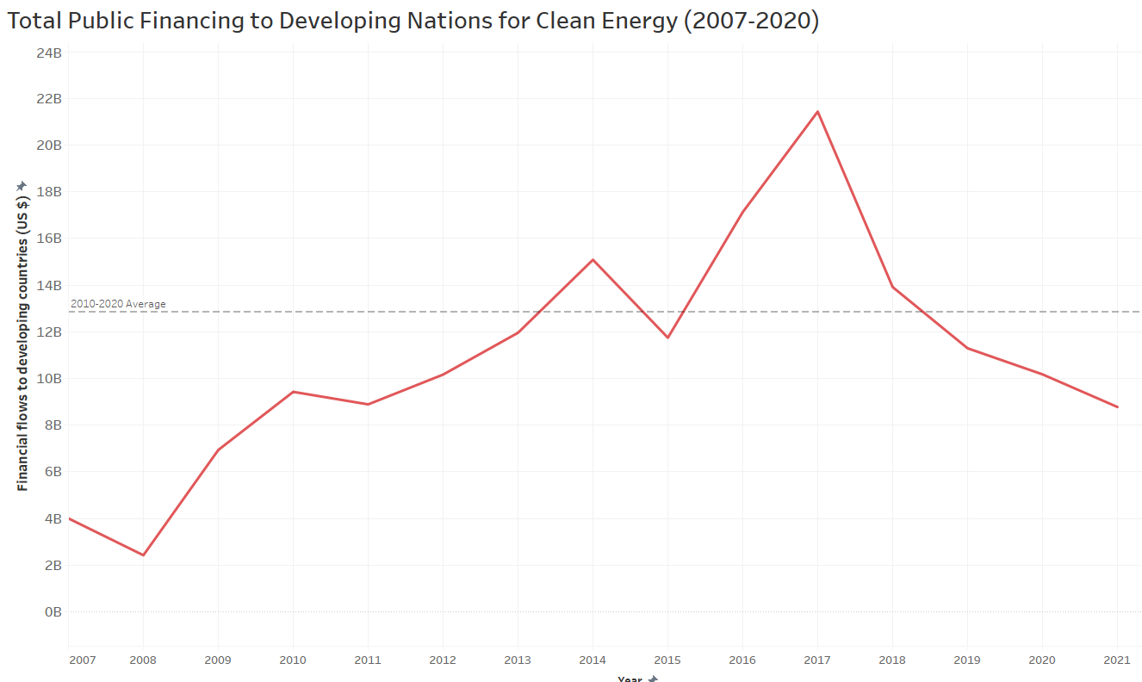
Volatility linked with international circumstances.
2017
Public Financing Peaks
2020
COVID-19
2011
Eurozone
Sovereign
Debt Crisis
2012
Recovery
of Eurozone
2015
EU Greek Debt Crisis
Falling Commodity prices
Paris Agreement
32%
2008
GFC
2016
Growing awareness of sustainable development
2010
Global resources boom
South Africa FIFA world cup
GFC recovery
2021
Funding 32% below decade average
Global COVID recovery
2018
Economic Secular Stagnation continues
Notes:
the current level of public investment is 32% below the decade average and is highly susceptible to fiscal and economic ailments such as covid, slowdowns and debt crises.

Slide 4

Volatility linked with international circumstances.
2017
Public Financing Peaks
2020
COVID-19
2011
Eurozone
Sovereign
Debt Crisis
2012
Recovery
of Eurozone
2015
EU Greek Debt Crisis
Falling Commodity prices
Paris Agreement
32%
2008
GFC
2016
Growing awareness of sustainable development
2010
Global resources boom
South Africa FIFA world cup
GFC recovery
2021
Funding 32% below decade average
Global COVID recovery
2018
Economic Secular Stagnation continues
Notes:
As the world pulls the plug on coal, can these nations just rely on shaky funding and financial obstacles or will things improve naturally without intervention.

